Slide 1

Budweiser Case Study
Authors: Rayon Morris & Sufiyan Mohammed
Next Gen Analytics

Slide 2

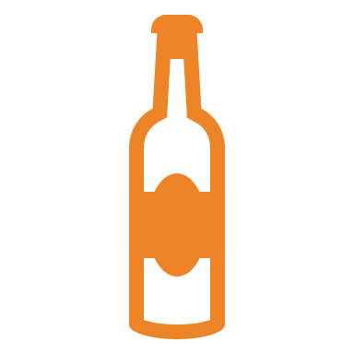

Contents
Introduction
Breweries per State
Missing Values
Comparison of Median ABV and IBU
ABV and IBU Maximums
Summary Statistics
Relationship between ABV and IBU

Slide 3
Introduction
This is a statistical analysis of the Beer Market for Mr. Michel Doukeris and Nick Caton, the CEO and CFO of Budweiser, respectively
This presentation focuses on the two main measurements of beer composition, Alcohol by Volume (ABV) and International Bitterness Units (IBU)
The analysis was completed using the provided Beers and Breweries datasets as sources

Slide 4
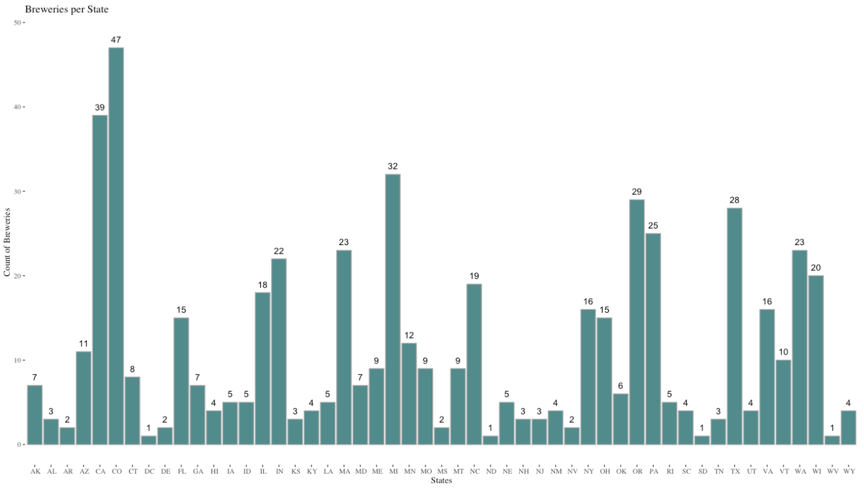
Breweries PER state

Slide 5
Missing Values
Variables with NA observations
ABV – removed NAs for the Median & Max ABV calculation
IBU – removed NAs for Median & Max IBU calculation
For further analysis on the relationship between IBU & ABV, all NA observations were removed from the dataset
Dataset reduced from 2,410 to 1,405 observations
58% reduction in usable data
No way to salvage missing data points while maintaining accurate calculations given time limitations

Slide 6
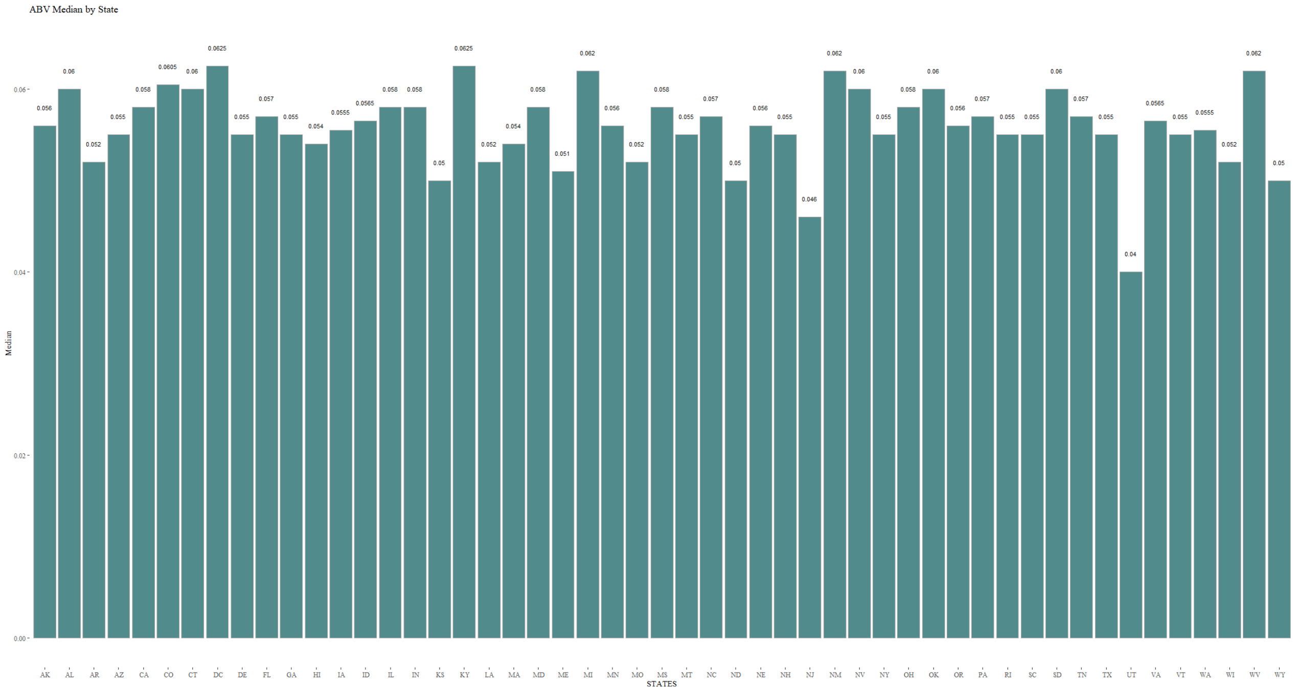
ABV Median by state

Slide 7
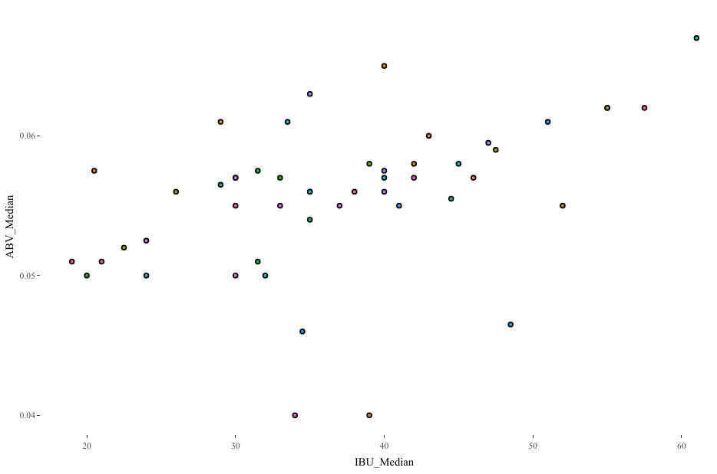
KEY Insights
The vast majority of the States have median ABV’s at or above 0.050
Some exceptions to this included states such as Utah, and New Jersey (0.046 and 0.04 respectively)
Utah has some strict regulations regarding alcohol sales (3.2% ABV limit on beers sold at supermarkets) Very difficult market to enter
New Jersey market has opportunity for expansion with a median ABV of 0.46
Notes:
We observed that the most frequent median was 0,050 and the others were above it.

Slide 8
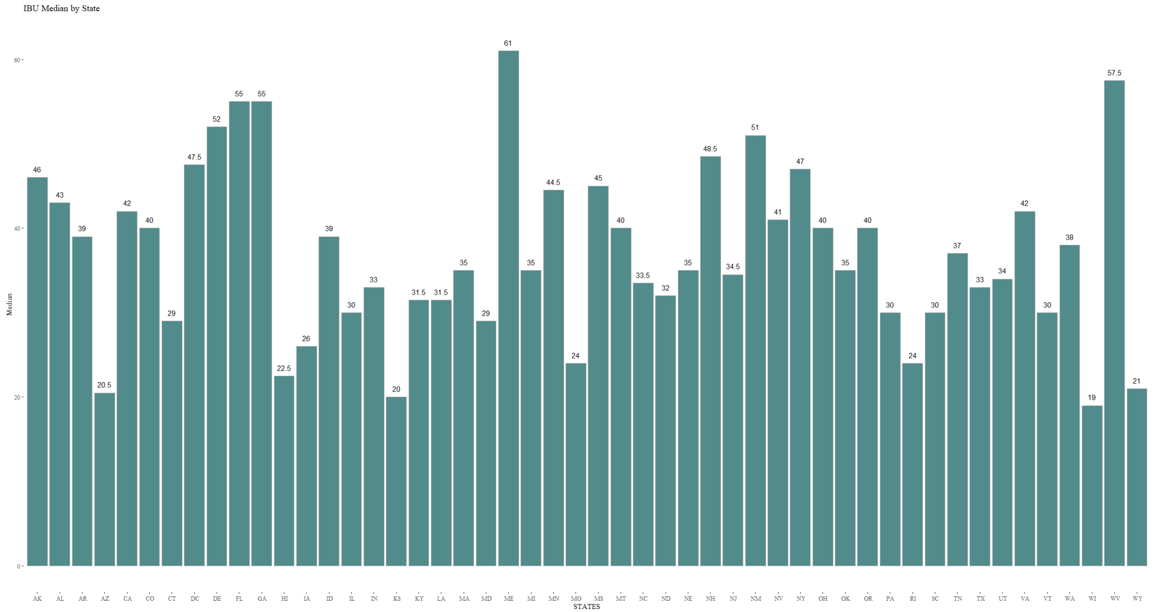
IBU Median by state

Slide 9
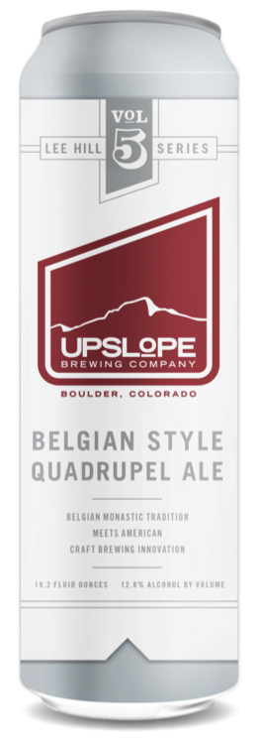
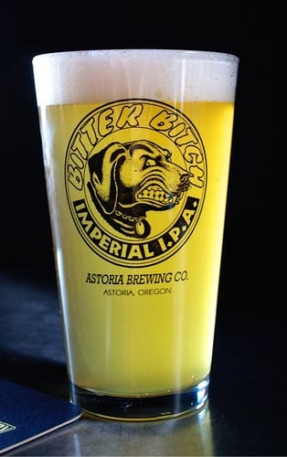
Maximums for ABV and IBU
ABV
IBU
The maximum ABV is 0.128 from the state of Colorado
Lee Hill Series Vol. 5 - Belgian Style Quadrupel Ale from Upslope Brewing Company
English
IBU of 35 (sourced from taphunter.com)
The maximum IBU is 138 from the state of Oregon
Bitter Bitch Imperial IPA from Astoria Brewing Company in Astoria OR
Style is American Double/Imperial IPA
ABV of 0.082

Slide 10
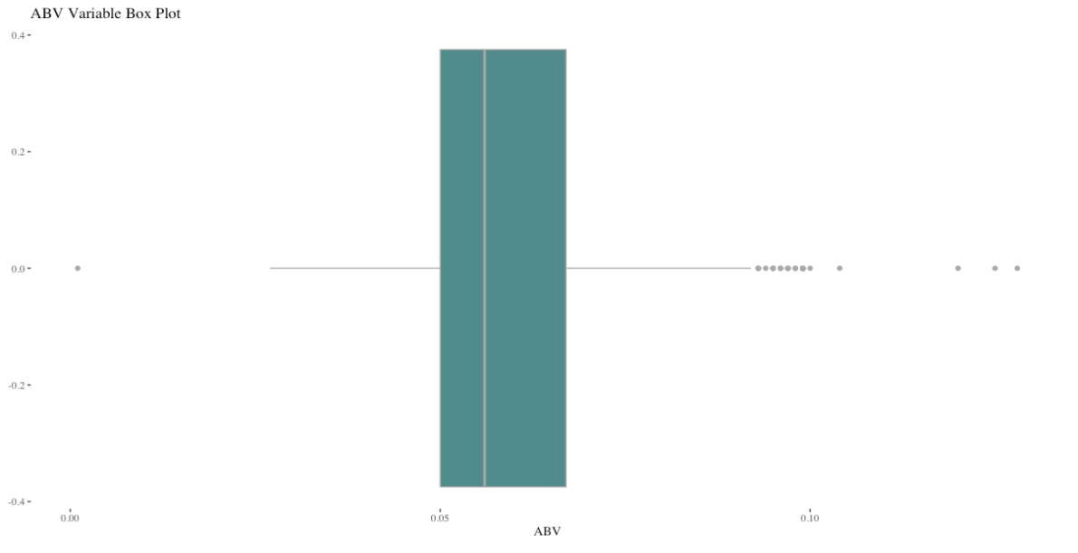
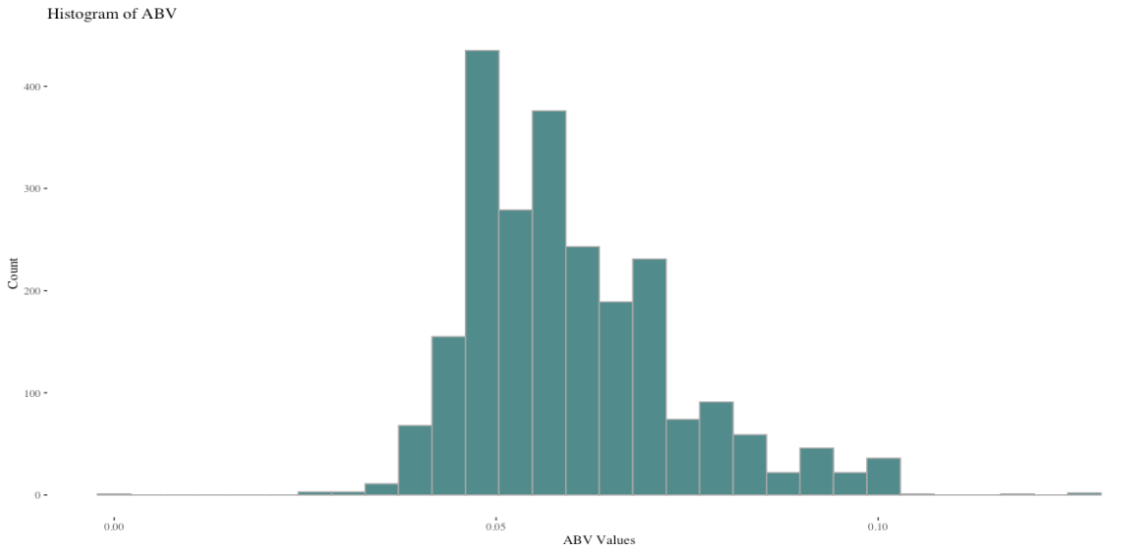
Summary Statistics And Distribution of ABV
Median 0.057
Quartile 3 is much larger than Quartile 2
Outliers at 0.125
Right skewed
Single mode at 0.05
Main outlier near 0.125 and 0 (low alcohol beer)

Slide 11
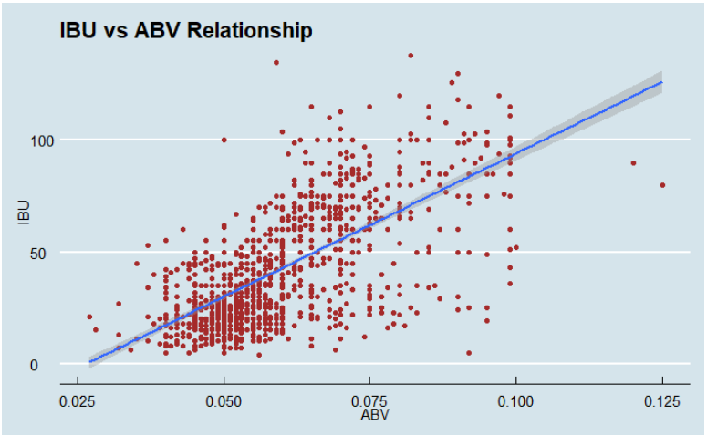
ABV vs IBU
There is a positive linear correlation of 0.671
Clustering around 0.05 ABV and 10-30 IBU
Vast majority of data points below 0.1 ABV except for the two outliers from KY and IN
IBU for these outliers expected to be higher, given the trend

Slide 12
KNN Classification
K= 5
Accuracy = 89%
Sensitivity = 85%
Specificity = 93%
Variables:
IBU
ABV
Style

Slide 13
References
GitHub: RayonM/MSDSCaseStudy1: MSDS Class Case Study (github.com)
Data Sources:
Beers.csv
Breweries.csv

Slide 14
Thank you
Sufiyan Mohammed
Rayon Morris

